Slide 1
OPERATING SYSTEMS
Razi Uddin
Lecture # 22

Slide 2


A typical instruction execution cycle, e.g., first fetches an instruction from memory, which is then decoded and executed.
Operands may have to be fetched from memory.
After the instruction has been executed, the results are stored back in memory.
The memory unit sees only a stream of memory addresses; it does not know how they are generated or what they are for (instructions or data).

Slide 3
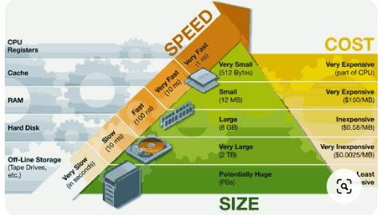
MEMORY HIERARCHY

Slide 4
MEMORY MANAGEMENT
The purpose of memory management is to ensure fair, secure, orderly, and efficient use of memory.
The task of memory management includes keeping track of used and free memory space.
As well as when, where, and how much memory to allocate and deallocate.
It is also responsible for swapping processes in and out of the main memory

Slide 5
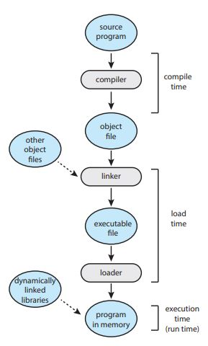
SOURCE TO EXECUTION

Slide 6
ADDRESS BINDING
Usually a program resides on a disk as a binary executable or script file.
The program must be brought into the memory it to be executed.
The collection of processes that is waiting on the disk to be brought into the memory for execution forms the input queue.
The normal procedure is to select one of the processes in the input queue and to load that process into the memory.
As the process is executed, it accesses instructions and data from memory.
Eventually the process terminates and its memory space becomes available for reuse

Slide 7
ADDRESS BINDING
Addresses in the source program are generally symbolic (such as an integer variable count). Address can be bound to instructions and data at different times.
Compile time—If you know at compile where the process will reside in memory, the absolute addresses can be assigned to instructions and data by the compiler.
Load time—If it is not known at compile time where the process will reside in memory, then the compiler must generate re-locatable code. In this case the final binding is delayed until load time.
Execution time—If the process can be moved during its execution from one memory segment to another, then binding must be delayed until run time. Special hardware must be available for this to work.
In case of compile and load time binding, a program may not be moved around in memory at run time.

Slide 8
LOGICAL-VERSUS PHYSICAL-ADDRESS SPACE
An address generated by the CPU is commonly referred to as a logical address.
Whereas an address seen by the memory unit–that is, the one loaded into the memory-address register of the memory–is commonly referred to as the physical address.
In essence, logical data refers to an instruction or data in the process address space.
Whereas the physical address refers to a main memory location where instruction or data resides.

Slide 9
LOGICAL-VERSUS PHYSICAL-ADDRESS SPACE
The compile time and load time binding methods generate identical logical and physical addresses.
Whereas the execution time binding method results in different physical and logical addresses.
In this case we refer to the logical address as the virtual address.
The set of all logical addresses generated by a program form the logical address space of a process.
The set of all physical addresses corresponding to these logical addresses is a physical address space of the process.
The total size of physical address space in a system is equal to the size of its main memory.
The run-time mapping from virtual to physical addresses is done by a piece of hardware in the CPU, called the memory management unit (MMU)

Slide 10
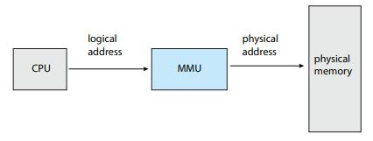

Slide 11
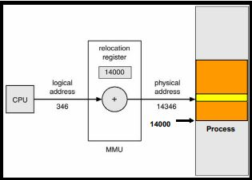
EXAMPLE

Slide 12
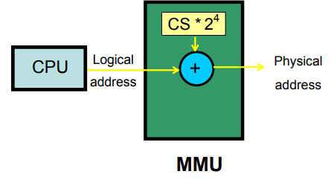
EXAMPLE (I8086)

Slide 13
DYNAMIC LOADING
So far, it has been necessary for the entire program and all data of a process to be in physical memory for the process to execute.
The size of a process has thus been limited to the size of physical memory.
To obtain better memory-space utilization, we can use dynamic loading.
With dynamic loading, a routine is not loaded until it is called.
All routines are kept on disk in a relocatable load format.

Slide 14
DYNAMIC LOADING
The main program is loaded into memory and is executed.
When a routine needs to call another routine, the calling routine first checks to see whether the other routine has been loaded.
If it has not, the relocatable linking loader is called to load the desired routine into memory and to update the program’s address tables to reflect this change.
Then control is passed to the newly loaded routine.

Slide 15
DYNAMIC LOADING
Advantages:
Less time is needed to load a program.
Potentially less memory space is needed.
Disadvantages:
Run time activity.

Slide 16
DYNAMIC LINKING AND SHARED LIBRARIES
Some operating systems support only static linking in which system language libraries are treated like any other object module and are combined by the loader into the binary proper image.
The concept of dynamic linking is similar to that of dynamic loading.
Rather than the loading being postponed until execution time, linking is postponed until run-time.
This feature is usually used with system libraries.
Without this facility, all programs on a system need to have a copy of their language library included in the executable image.
This requirement wastes both disk space and main memory

Slide 17
DYNAMIC LINKING AND SHARED LIBRARIES
With dynamic linking, a stub is included in the image for each library-routine reference.
This stub is a small piece of code that indicates how to locate the appropriate memory-resident library routine or how to load the library if the routine is not already present.
During the execution of a process, the stub is replaced by the address of the relevant library code, and the code is executed.
If library code is not in memory, it is loaded at this time

Slide 18
DYNAMIC LINKING AND SHARED LIBRARIES
This feature can be extended to update libraries.
A library may be replaced by a new version and all programs that reference the library will automatically use the new version without any need to be re-linked.
More than one version of a library may be loaded into the memory and each program uses its version information to decide which copy of the library to use.
Only major changes increment the version number.
Only programs that are compiled with the new library version are affected by the incompatible changes incorporated in it.
Programs linked before the new library was installed will continue using the older library.
This system is also known as shared libraries.

Slide 19
DYNAMIC LINKING AND SHARED LIBRARIES
Advantages:
Less time is needed to load a program.
Potentially less memory space is needed.
Less disk space is needed to store binaries.
Updated libraries are used without recompilation of the program.
Disadvantage:
Time-consuming runtime activity.
Resulting in slower program execution.
gcc compiler performs dynamic linking by default
-static can be used for static linking.

